Slide 1

Eclipse Installation Step by Step Document

Slide 2
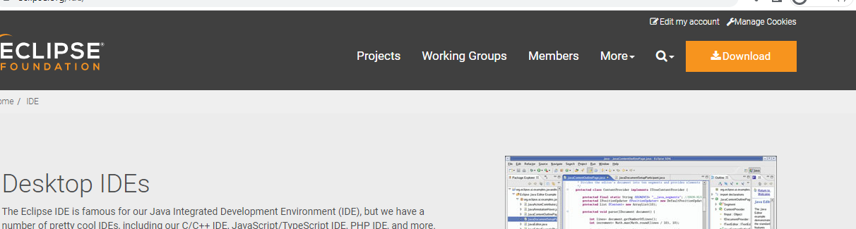
Firstly serach for Eclipse IDE in your favourite browser or I have given link for your reference.
https://www.eclipse.org/ide/
After opening the link you will directed to a page like I have shown in image.
Select download at the right edge.

Slide 3
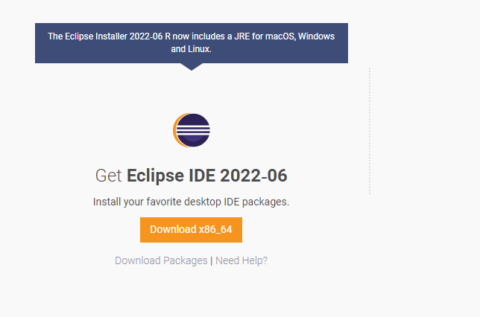
After clicking download you will directed to a page like this.
Click download in this page
Image added for your reference.

Slide 4
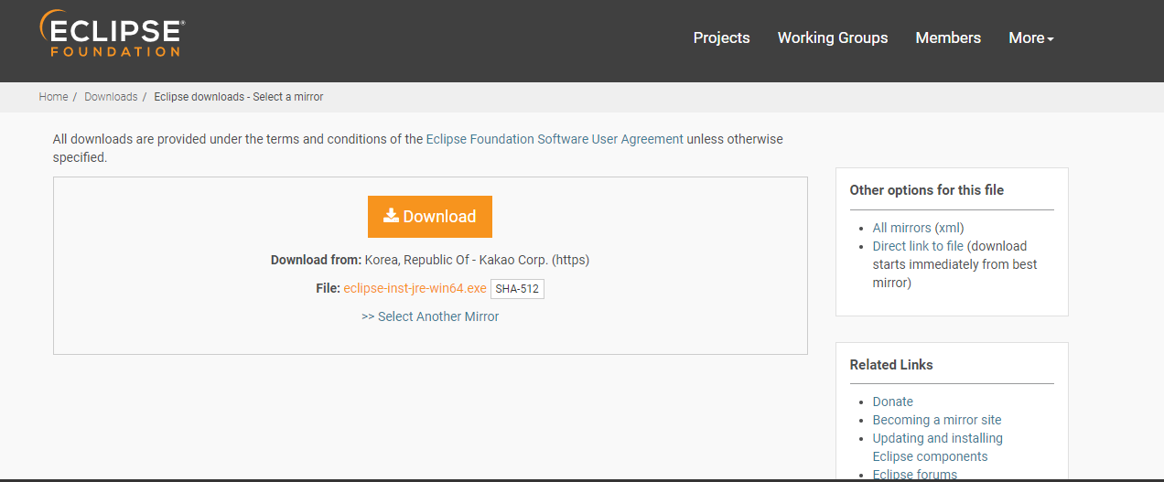
After selecting download option you will directed to a page like this.
In this page you can executable file.
Select download to download the executable file.
Image added for your reference.

Slide 5
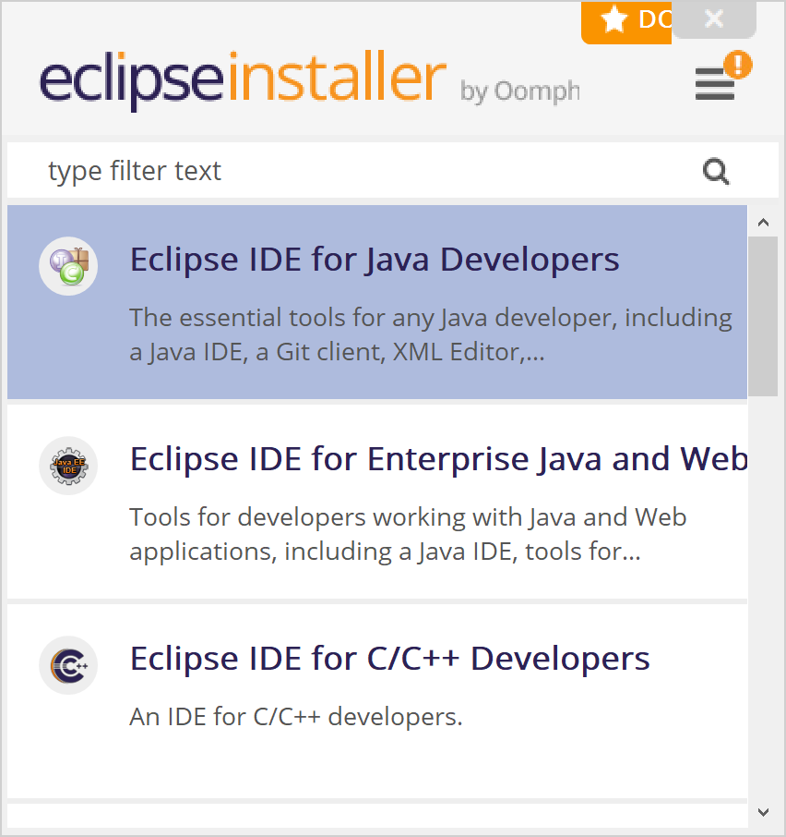
After downloading, open the .exe file.
Double click the executable file to open it.
You will get a interface like this.
Select Eclipse IDE for Java Developers.

Slide 6
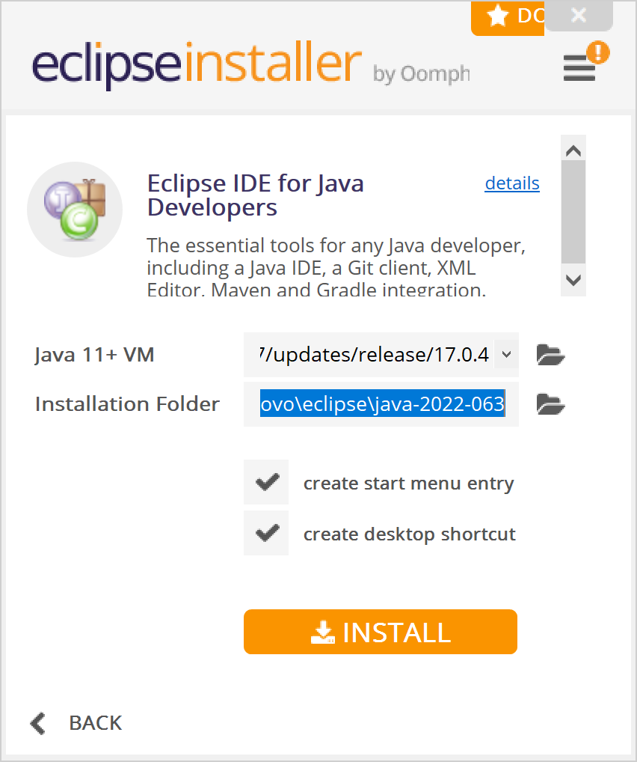
After selecting Eclipse IDE for java developers, you will be asked for install. Please select 2checkboxes above install option.
Select install and installation process will start.

Slide 7
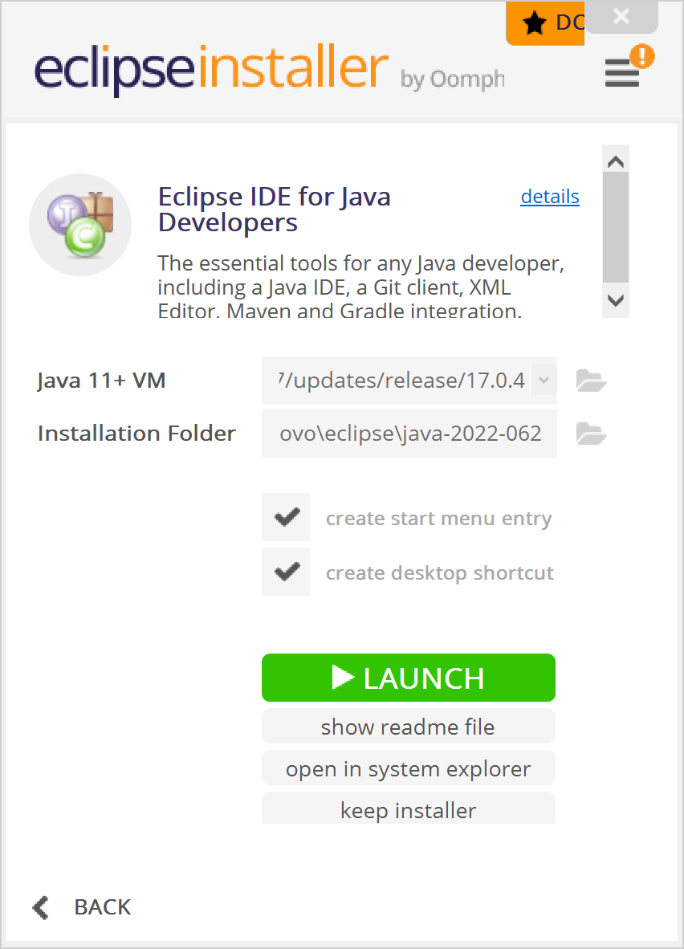
After installation process completes, you will be asked to launch.
Select launch option.
Image added for your reference.

Slide 8

After selecting launch Our Eclipse IDE will open like this.

Slide 9
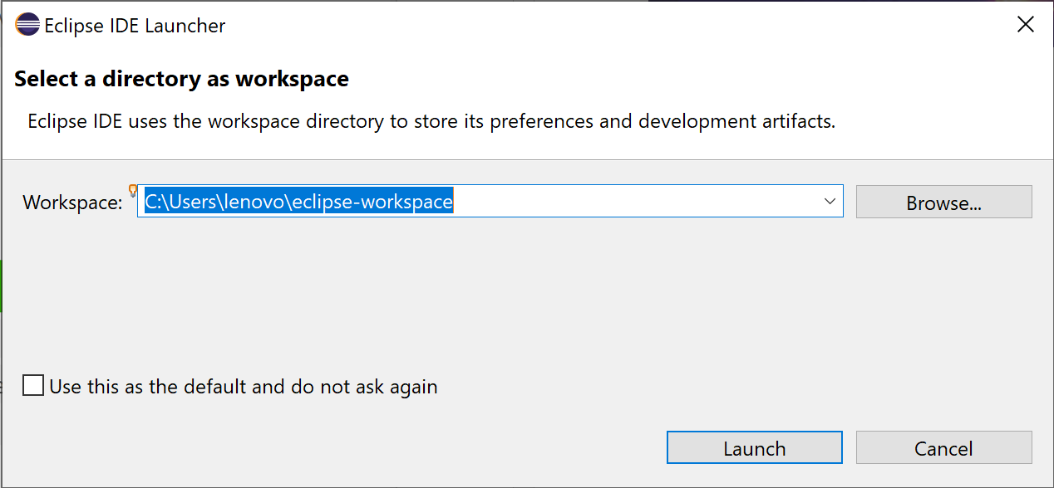
After opening Eclipse will be asked for default path for our work to be stored.
If you want to change to your required path you can change or you can keep the same path and click launch.

Slide 10
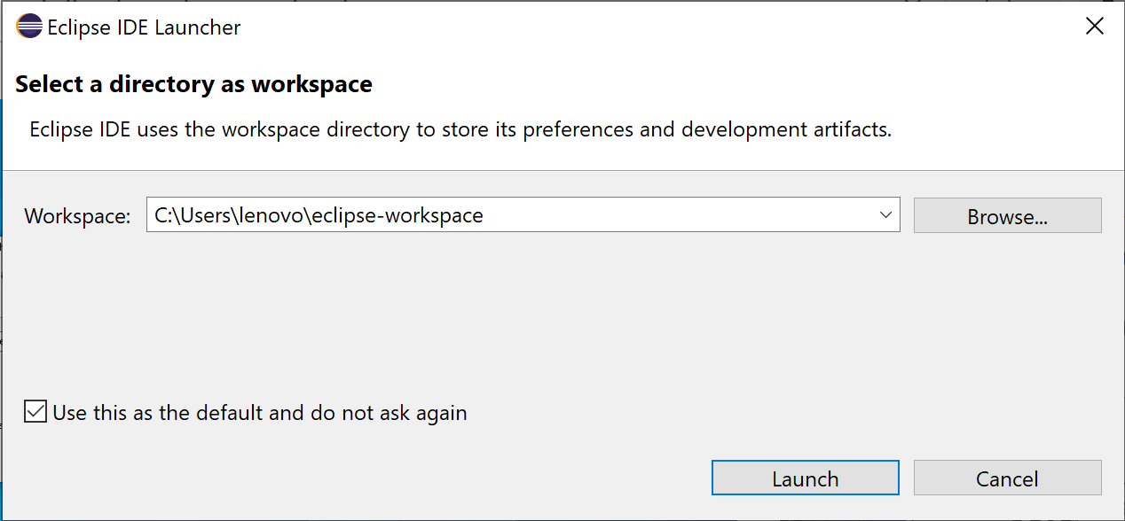
If you want the same path for every time and if you don’t wish to select your path everytime when you work on eclipse. You can select the checkbox and click launch so that it wont ask you for path again.

Slide 11
Feel free to ask any doubt in the installation process.
THANK YOU.
HAPPY LEARNING.
- Team FLM.

